Slide 1

Network Topologies

Slide 2
Chapter Objectives
Explain the different topologies
Explain the structure of various topologies

Slide 3
Questions Time Limit – 5 Mins
What is a switch and explain the working of switch in a network?
What is a gateway? Is firewall a gateway device?
What is a router?

Slide 4
Topology
Provides different configurations that are used to create a network
Is a pattern of network devices and describes the way in which these devices are connected.
Topologies can be physical or logical.
Physical topology refers to the actual physical structure of the network, while a logical topology determines the way in which the data actually passes through the network from one device to other.

Slide 5
Types of Topologies
Bus
Star
Ring
Mesh
Tree
Hybrid

Slide 6
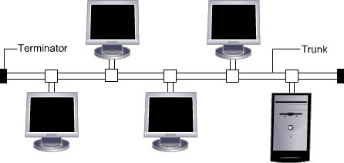
Bus topology - I
All devices are connected to a common cable called backbone/trunk
Operates in daisy chain fashion
Medium is shared that’s why creates collision

Slide 7
Question Time Limit – 3 Mins
List the different types of topology.

Slide 8
Bus topology - II
Server is at one end and devices are at different positions
50 ohm terminators are used
Devices are not responsible for data transmission

Slide 9
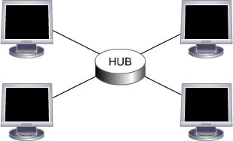
Star Topology - I
Each device is connected to a central device called hub through cable
Data passes through hub before reaching destination

Slide 10
Star Topology - II
Advantages:
Easy to install, configure, manage and expand
Centralized management
Addition or removal of device does not affect the whole network
Disadvantages:
Requires more cable
Failure of hub affects entire network
More Expensive

Slide 11
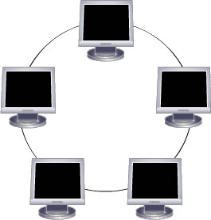
Ring Topology - I
Devices are connected in a closed loop
All devices have equal access to media
Device waits for its turn to transmit
Most common type is Token Ring network

Slide 12
Ring Topology - II
Advantages:
Reliable and offers greater speed
No collisions
Handles large volume of traffic
Disadvantages:
More cabling is required compared to bus topology
One faulty device affects the entire network
Addition of devices affect network

Slide 13
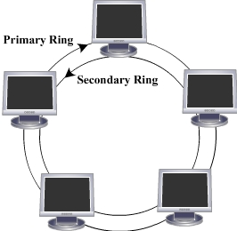
Dual Ring Topology
Consists of two independent primary and secondary rings
Secondary ring is redundant, used only when primary stops functioning

Slide 14
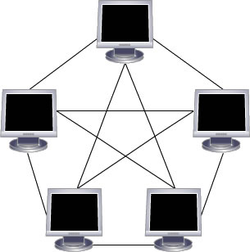
Mesh Topology - I
Used in WANs to interconnect LANs
Every device is connected to every other device
Use routers to determine the best path of communication

Slide 15
Mesh Topology - II
Types
Full mesh
Partial mesh
Full mesh topology – All devices are connected to each other
Partial mesh topology - Some devices are connected to only those with whom they exchange most of the data

Slide 16
Mesh Topology - III
Advantages:
Improves fault tolerance
Failure of one link does not affect entire network
Centralized management is not required
Disadvantages:
Difficult to install and manage
Each link from one device to other requires individual NIC
Expensive

Slide 17
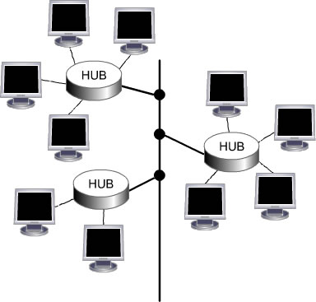
Tree Topology - I
Combines the characteristic of linear bus and star topology
Devices are wired to root hub
Twisted pair cable is commonly used
Lowest level devices are smaller computers

Slide 18
Question Time Limit – 3 Mins
Explain the difference between ring and mesh topology.

Slide 19
Tree Topology - II
Advantages:
Easy to expand the network
Point-to-point wiring for each device
Fault detection is easy
Disadvantages:
Difficult to configure
If backbone breaks, entire network goes down
More expensive

Slide 20
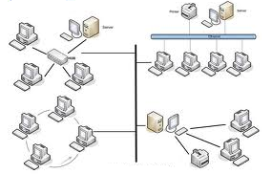
Hybrid Topology - I
Hybrid topology is a network where two or more topologies are connected in such a way that the resulting network does not have one of the standard forms.

Slide 21
Hybrid Topology - II
Advantages:
Used for creating larger networks
Handles large volume of traffic
Fault detection is easy
Disadvantages:
Installation and configuration is difficult
More expensive than other topologies
More cabling is required

Slide 22
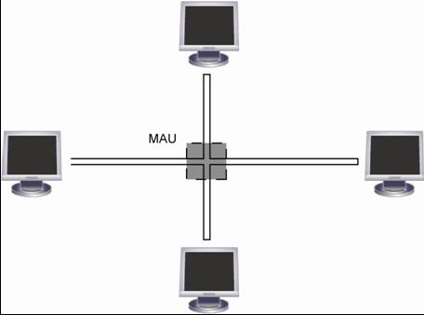
Logical Vs Physical Configuration
Physical topology - Defines how the systems are physically connected
Logical topology - Defines how the systems communicate across the physical topologies

Slide 23
Summary - I
Topology is a pattern of network devices and describes the way in which these devices are connected.
Physical topology refers to the actual physical structure of the network, while a logical topology determines the way in which the data actually passes through the network from one device to other.
Different types of topologies are Star, Bus, Ring, Mesh, Tree and Hybrid
Bus topology connects each device to a single cable and at either end of the cable terminator is used to remove unsent data from the cable

Slide 24
Summary - II
In star topology, multiple devices are connected to a central connection point known as hub or switch
In a ring topology, data travels around the loop in one direction and passes through each device
In a mesh topology, every device is connected to each and every node in the network with many redundant interconnections and at least two paths to and from every node
Tree topology connects multiple star networks to other star networks using bus topology.
Hybrid topology is a combination of two or more different topologies.

